Slide 1



HealthInfoNet – Project Summary, Conclusions and Next Steps
Maine State Innovation Model Test Grant
September 28, 2016

Slide 2
HealthInfoNet’s SIM Objectives
Provide Maine patients with access to their statewide HIE record leveraging “Blue Button” standards in a 12-month pilot.
Provide real-time notifications from the HIE to MaineCare when MaineCare members are admitted or discharged from inpatient and emergency room settings.
MaineCare Analytics Dashboard:
Provide a Dashboard from the HIE enabling MaineCare to clinically monitor members’ health care utilization and outcomes at the population and individual level.
Develop and deploy real-time discrete data feeds for MaineCare claims and prescription data to HIN for HIE and Analytics inclusion
Provide HIT and HIE adoption reimbursements (1.4 million) to up to 20 Behavioral Health provider sites/organizations.
Provide HIE access to Behavioral Health providers.

Slide 3
HIE Blue Button Pilot

Slide 4
Patient Portal “Blue Button” HIE Access Overview
Objective:
Provide Maine patients with access to their statewide HIE record leveraging the “Blue Button” standards promoted by the Office of the National Coordinator for HIT (ONC). HIN will conduct a 12-Month Pilot with a provider organization to make the patient chart available via a certified EHR Portal administered by the pilot site.
Hypothesis:
If HIN creates the technical solution to provide patients with direct access to their state-wide HIE record Continuity of Care Document (CCD) via their local provider's Patient Portal; patients will access their CCD to better engage in their care.

Slide 5
Patient Portal HIE Blue Button – SIM Impact
SIM Pillar supported: Engage People and Communities
SIM CORE Metrics impacted: Patient Experience/Engagement, Fragmented Care
Objective impact:
This 12 month objective completed in July 2015 was the first State effort to get patients access to their comprehensive health record managed by the HIE.
This effort allowed over 500 Eastern Maine Health System patients to access their HIE record via their local community providers health record “portal”.
The patient cohort found value in having ready access to their statewide record.
It serves as a model whereby the HIE can support the objectives of health providers to give patients ready access to their medical information and to empower them to be more involved in their medical decision making.
Sustainability cost: Variable costs dependent on the provider-based EHR systems.

Slide 6
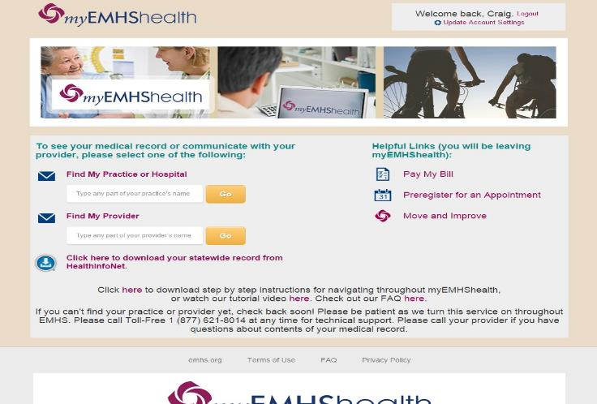
EMHS Patient Portal HIE Blue Button

Slide 7
Data Collection Methods
The project team collected qualitative and quantitative data to gauge consumer understanding and engagement with the Blue Button technology through:
Number of CCD downloads
5 question pop-up survey at time of download
Practice patient advocacy groups
Practice staff involved with the project
5 question patient email survey

Slide 8
EMHS Pilot Statistics
Initial pilot cohort: 760 active myEMHShealth portal users
Across 3 primary care practices:
EMMC Internal Medicine, Husson
EMMC Family Medicine, Brewer
SVH Family Care, Pittsfield
EMHS Results
Total number of downloads: 546 patients
Total number of pop-up survey results: 169
Total number of email survey results: 421
Notes:
Katie

Slide 9
Key Lessons Learned
Patient call volume to HIN with questions was low
HIN CCD format and presentation using Blue Button is “easy” for patients to understand
Confusion for patients: their local portal vs. HIN data
HIN’s relationship to the provider can be confusing but is an opportunity to expand patient portal access and utilization
Having web-based access to the “statewide” record is positive; convenient; covers you on short notice & emergencies while traveling
Patients want access to their “doctor’s notes”
More specified data structure standards are needed

Slide 10
Blue Button Conclusions
The pilot was a success; with the opportunity patients will use the HealthInfoNet Blue Button technology when the market is ready
HIN can provide a technical solution for patient access using the Blue Button-Patient Health Record strategy
Patients want more access to their health information than the current access provides
Patients want to view their health record information with a interactive web-based product in addition to downloading their information
Portal access is fragmented; patients want “one place” to access “all” of their records
Overall patients need more education about health information technology and Maine’s health information exchange

Slide 11
HIE Notifications

Slide 12
HIE Notifications Overview
Objective:
Provide real-time notifications from the HIE to MaineCare and health system Care Managers when MaineCare members are admitted or discharged from inpatient and emergency room settings across all provider organizations connected to the HIE.
Hypothesis:
If HIN can release, build, and deliver real-time ADT & document notifications to MaineCare Care Management staff; MaineCare will have increased their data resources and thereby add efficiencies in staff workflows that will improve the desired results related to appropriate member ED/Admissions utilization.

Slide 13
HIE Notifications - SIM Impact
SIM Pillars supported: Strengthen Primary Care, Centralize Data & Analysis
SIM CORE metrics impact: ED Utilization, Readmissions, Fragmented Care
Objective impact:
HIN provides near real-time notifications for MaineCare patients presenting in Emergency Department and Inpatient settings. MaineCare Care Management and provider organizations connected to the HIE receive emails continuously.
This service actively supports near-real time tracking and member intervention with MaineCare Members and is used to specifically support the current paper-based ED diversion initiative.
HIN expanded the project and its interfaces to include ED admission “chief complaint” information.
All hospitals are sending “chief complaint” to HIN.
For Year 4/No Cost Extension, HIN will be expanding notifications to include ED and Inpatient admissions.

Slide 14
HIE Notification Conclusions
HealthInfoNet’s notification service provides 4 unique values to healthcare reform efforts in Maine:
The HIE is uniquely capable to automate near real-time notifications about MaineCare member utilization of ED and inpatient admissions.
The HIE offers a centralized statewide solution which brings efficiency to the workflow and process.
The HIE offers the automated identification of members who are over utilizing specific services by MaineCare’s custom definition (ED/inpatient, etc.)
By automating the identification of members, Care Managers can spend more time intervening and collaboration with primary care providers, health homes etc. to impact behavior and member experience of the health care delivery system.
The HIE is the only current solution to automate in near real-time the delivery of discharge documentation for ED and inpatient events of care for members.

Slide 15
Clinical + Claims Analytics to Support Care Management of MaineCare Patients

Slide 16
MaineCare Analytics
Objective:
Provide a Clinical Analytics Dashboard to MaineCare and clinicians from the HIE enabling care managers to monitor MaineCare Members’ health care utilization and outcomes at the population and individual level
Develop and deploy real-time discrete data feeds for MaineCare medical and prescription claims data to the HIE and HIN Analytics platform
Hypothesis:
If HIN has access to MaineCare claims files, HIN can build an interactive analytics dashboard that presents clinical HIE and claims data to care managers. This dashboard can be used by clinical teams and DHHS to support/inform policy and program activities addressing utilization, member outcomes, and improving care management and prescription medication workflows
Merging Medicaid Claims and HIE data results in significant improvement in risk scoring/stratification
If HIN has access to MaineCare Claims files, HIN will be able to integrate discrete MaineCare medical and prescription claims data into the Clinical Portal

Slide 17
MaineCare Analytics – SIM Impact
SIM Pillar supported: Centralize Data and Analysis
SIM CORE metrics impact: Pediatric/Adolescent Care, Mental Health, Obesity, Diabetes Care, ED Utilization, Readmissions, Imaging, Fragmented Care, and overall cost utilization reduction goals
Objective impact:
This objective supports MaineCare and clinician access to near real-time information by narrowing the focus for proactive risk management for members that are at identified for:
Being high-cost
High risk for incidence of inpatient and emergency department events of care
For actively developing key chronic illnesses
The risk models, developed using the HIE clinical data and claims data from MaineCare allows access to actionable risk-information that care managers and clinicians otherwise wouldn’t have.

Slide 18
Medicaid Claims + Clinical Data = Improved Risk Scores
Through a SIM grant, HIN Tested the hypothesis that: Merging Medicaid Claims and HIE data resulted in significant improvement in risk scoring/stratification
For most models the addition of claims data improved the risk scores
Better sensitivity at the higher risk bin levels
Better c-statistics (0.64-0.9)
Better r-squared statistics
Key data available in the Claims data and not in the EHR data were shown as key features for several models
Mental health diagnosis codes: Mood Disorders, Anxiety Disorders,
CPT codes
Medication claims
Claims diagnosis codes filling the EHR diagnosis gaps (~40-50% EHR encounters missing some diagnosis codes)

Slide 19


Case Study: St. Joseph Healthcare
Healthcare system in Bangor, Maine
112 bed acute care community hospital
Primary care and specialty physician practices
24,000 covered lives
Partner with FQHC
Participates in several ACOs
Medicare shared savings
Medicaid
Commercials
Using real-time predictive risk scores (Calculated with HIE + MaineCare Data) to manage patients daily

Slide 20









Workflow: Acute to Ambulatory Patient Risk Management
Post discharge, St. Joseph’s PCP patients are handed off to ambulatory care manager for follow up.
Patient risk scores drive post-discharge care plan.
St. Joseph’s Ambulatory Patients
Discharged to St. Joe’s PCP
Discharged to community PCP
Community At Large

Slide 21






St. Joseph Healthcare Results
Compared to the state-adjusted rates
15.0% reduction in emergency room visits
9.5% reduction in 30-day ED return rate
4.2% reduction in admissions
13.0% reduction in 30-day readmissions
12.1% reduction in inpatient days
5.0% reduction in cost per person

Slide 22
MaineCare Analytics Conclusions
Integration of monthly MaineCare pharmacy claims into the HIE medication history list is critical for care management and medication reconciliation for clinicians across the state for all MaineCare members
Reduces fragmentation of care across multiple prescribers and emergency rooms
Improves the quality of medication reconciliation
Reduces medication error and medication redundancies resulting in lower overall costs and improved outcomes
Providing future risk prediction information of ED, inpatient admissions, and high-cost MaineCare members:
Supports early intervention care management to prevent cost
Improves communications and coordination between MaineCare and providers
May result in more accurate caseload and forecasting as MaineCare enters into risk-based contracts
Supports improved outcomes for members
There are additional provider-centric use-cases (utilization risk, disease prediction) that will be tested in SIM Year 4 NCE.

Slide 23
Behavioral Health Objectives

Slide 24
Behavioral Health HIT Reimbursement
Objective:
Provide HIT and HIE adoption reimbursements ($1.4 Million/$70,000 each) to up to 20 Behavioral Health provider sites/organizations.
Hypothesis:
If BH organizations in Maine have access to funding reimbursements to support EHR interoperability improvements and HIE connection, they will choose to invest in their EHR and participate in Maine’s statewide HIE.

Slide 25
BH HIT Reimbursement – SIM Impact
SIM Pillars supported: (from SIM Strategic Framework): Integrate Physical and Behavioral Health, ED Utilization, Fragmented Care
SIM CORE Metrics impact: (from SIM Core Metrics): Fragmented Care, Mental Health, Diabetes Care
Objective impact:
This objective supports community-based mental health providers in adopting heath information technologies (HIT) that support clinical integration of all services that a patient/consumer is receiving (mental health and physical health).
EHRs and HIE interfacing costs are being supported under this objective in order to make sure that clinicians in these locations have the right information on the right patient at the right time.
The funds that are being provided to each of the 20 organizations involved are being used to support staff time, contractors, licenses and support fees related to their adoption of HIT tools that are both interoperable (can support HIE) and can measure quality of care delivered.

Slide 26
Behavioral Health HIE Goals
Implement connections between 20 BH organizations and the Health Information Exchange
Train BH staff to leverage EHR and HIE services
Document and share “Data Informed” workflows for patient care improvement
Build data interfaces and go live with initial data available from each BH organization
Support quality improvement aimed at reducing ED Utilization and measure impact (“Observational Analysis”)

Slide 27
Behavioral Health HIE– SIM Impact
SIM Pillars supported: Integrate Physical & Behavioral Health, Centralize Data & Analysis, Engage People & Communities
SIM CORE metrics impact: Fragmented Care, Mental Health, Diabetes Care, ED Utilization, Readmission, Imaging, Fragmented Care
Objective impact:
All 20 BH organizations have access to their patients statewide health records and are actively using the tools within their care coordination workflows to improve coordinate care regarding the physical health issues of their patients.
13 BH organizations are live with sharing mental health records to benefit the general practitioners, specialists and hospitals. The remaining 7 are working to complete the data integration process through SIM Year 4 NCE.
HIN rolled out the new mental health opt-in consent model with each organization and active opt-in participation continues to climb with over 5,000 patients opted-in to date.
For patients, this initiative supports their ability to choose to share their mental health information with all of their providers.

Slide 28
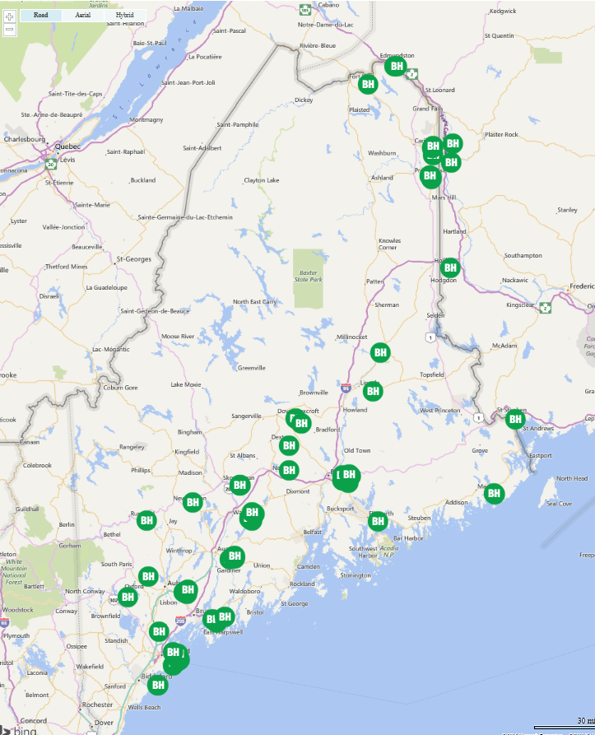
BH Connections as of August 2016
75 Site Locations Accessing HIE
13 of 20 Live with Data Sharing
Aroostook Mental Health Center
Assistance Plus
Charlotte White Center
Cornerstone Behavioral Healthcare
Crisis & Counseling Centers
Julie Racine, NP
Maine Behavioral Health Organization
Northeast Occupational Exchange
OHI
Pathways (Providence)
Restorative Health
Sweetser
United Cerebral Palsy

Slide 29
BH Staff Active HIE Access May 2015 - August 2016

Slide 30
Population Impact May 2015- August 2016
Patient Records Accessed by Behavioral Health Staff

Slide 31
“Data Informed” Workflows Documented
Targeted Care Management Services
Hospital Discharge Planning
Comprehensive Transitional Care; Post ED and Hospital Follow up
Identification and Coordination with Client’s Care Team
Medication Reconciliation
Client Engagement and Education; Using the Client’s HIE record
Intervention with Client Following a Medical Event while Waiting for Reports from Medical Providers
Assessment of Accuracy of SMI Diagnosis vs. Medical Diagnosis with Medical Provider
Identification of Gaps / Overuse of Medical Care
Location of Missing Clients

Slide 32
Value of HIE in Managing Mental Illness and Chronic Disease
Reduce fragmentation with medical community
Mitigate medical issues that contribute to Mental Illness
Identify prescriptions, both unknown and duplicated
Provide a safety net, locate clients and intervene
Provide integrated BH intervention to address medical issues and reduce unnecessary ED visits
Able to replace hours spent in getting permission to view a client’s record to provide care for clients
Able to relieve stress and anxiety around medical care

Slide 33
BH Quality Project Goals January-July 2016
Implement real-time notifications for ED/hospital admissions to intervene with clients with a history of 2 or more ED visits within a 6 month period
Access the HIN Portal to coordinate care with both the client & medical community
Leverage “Data Informed” workflows with all organizations and convene monthly “learning community” to share lessons learned
Measure change in ED utilization at the end of 6 month period (“Observational Analysis”)

Slide 34
MaineCare BH Quality Project Observational Analysis Overview
Hypothesis – Integrated care interventions that include medical record data and real-time notifications will reduce ED utilization for patients
Patients chosen for inclusion based on 2 or more ED visits in the 6 month “pre-intervention” period
A list of 800+ patients was provided to the 18 BH organizations to determine appropriateness for intervention
A observation panel of 443 patients were selected by the 18 BH organizations participating

Slide 35
Observational Analysis Results (Preliminary)

Slide 36
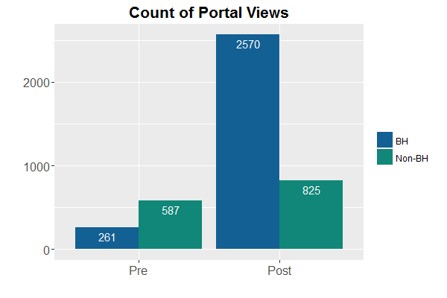
HIE Portal Views of Cohort Patients
Portal views increased in the post-intervention period, mostly by users from behavioral health facilities

Slide 37
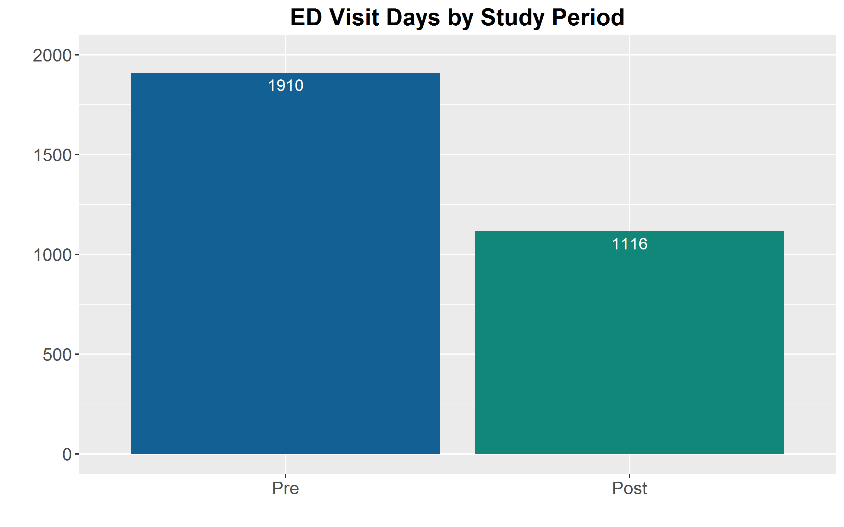
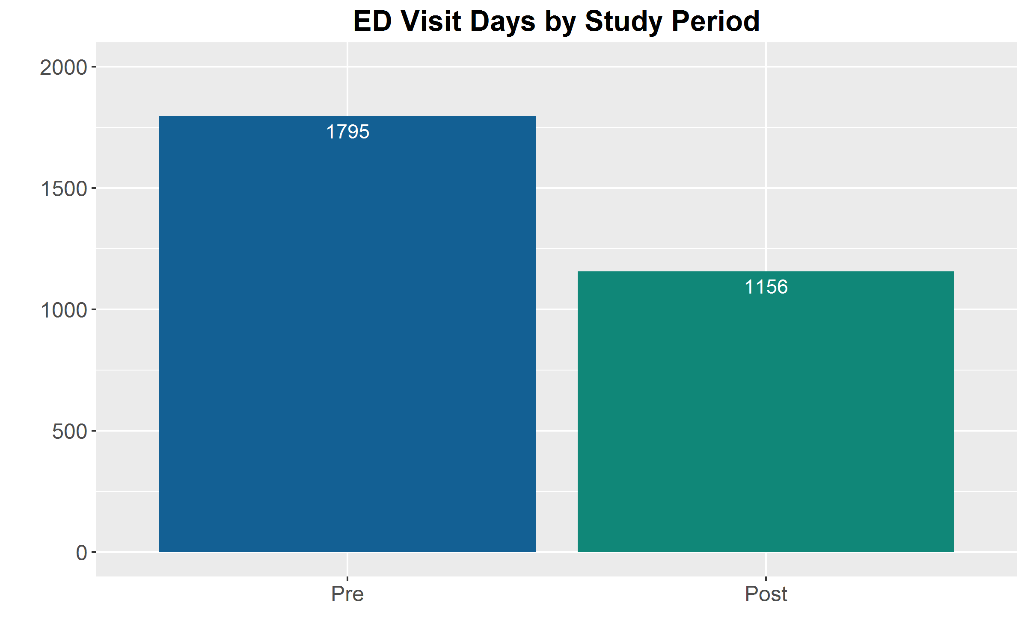
ED Visit Days
Claims Data
CDR Data
There was a 35%+ reduction in ED Visit Days for the cohort population in the post intervention period

Slide 38
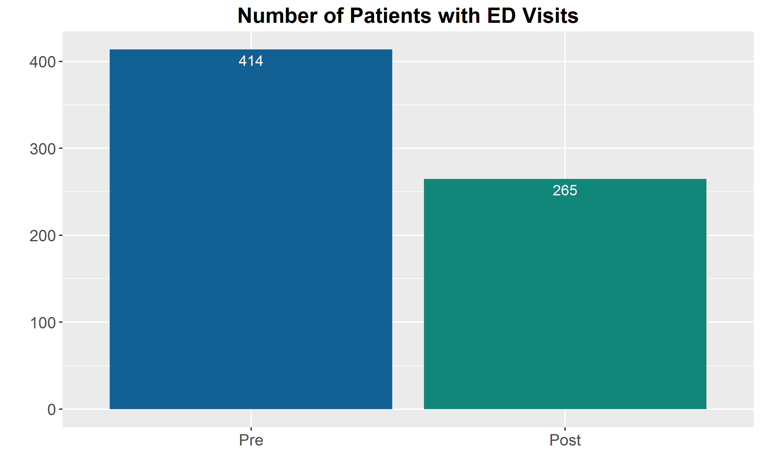
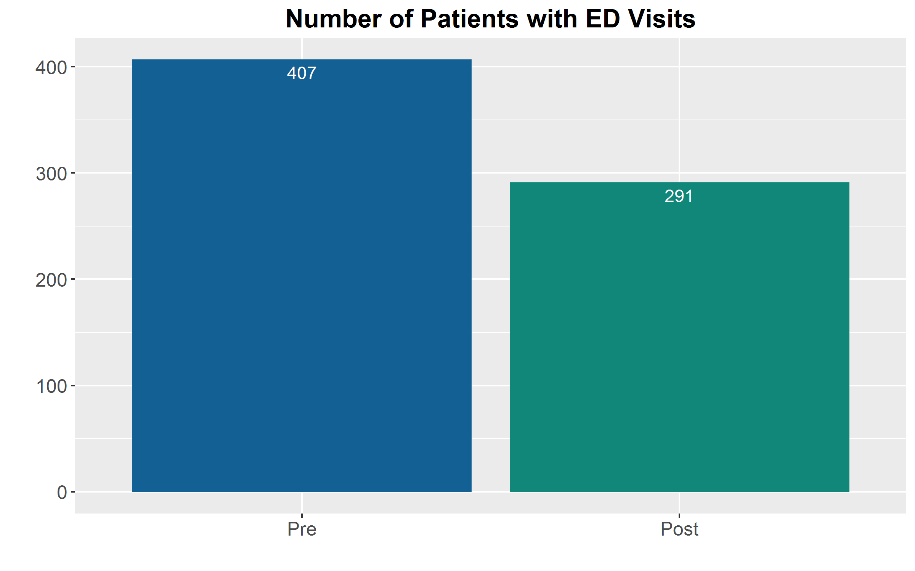
Patients with ED Visit Days
Claims Data
CDR Data
There was a 30%+ reduction in patients having ED visits in the post intervention period

Slide 39
Total ED Visit Rates
Mean ED Visit Rate for All patients (HIE Data)
Pre Intervention: 4.4 visits / 6 month period
Post Intervention: 2.7 visits / 6 month period
Mean ED Visit Rate for Patients with ED visits (HIE Data)
Pre Intervention: 5.1 visits / 6 month period
Post Intervention: 4.1 visits / 6 month period

Slide 40
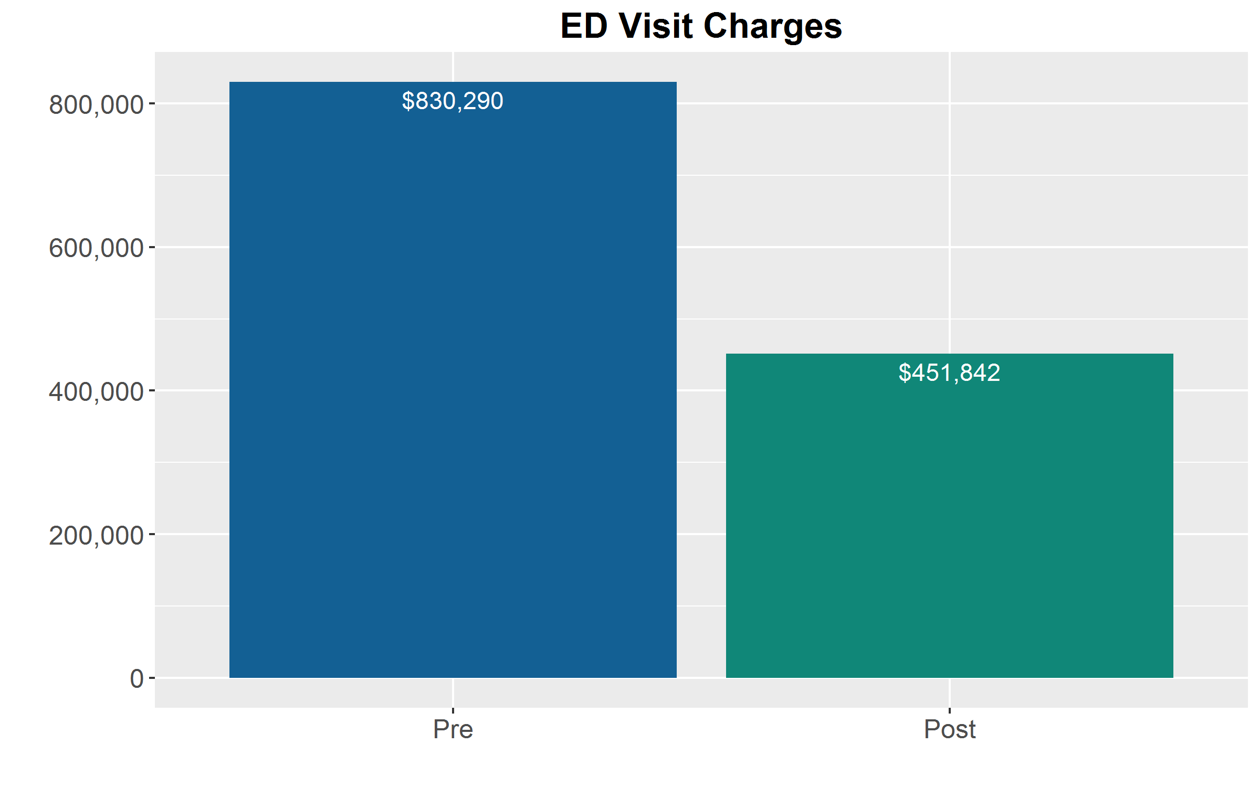
ED Visit Charges
During the post intervention period ED visit charges were $378,448 (46%) less
Note – These figures do not include ancillary, pharmacy, consultant or facility charges.
Claims Charge Data

Slide 41
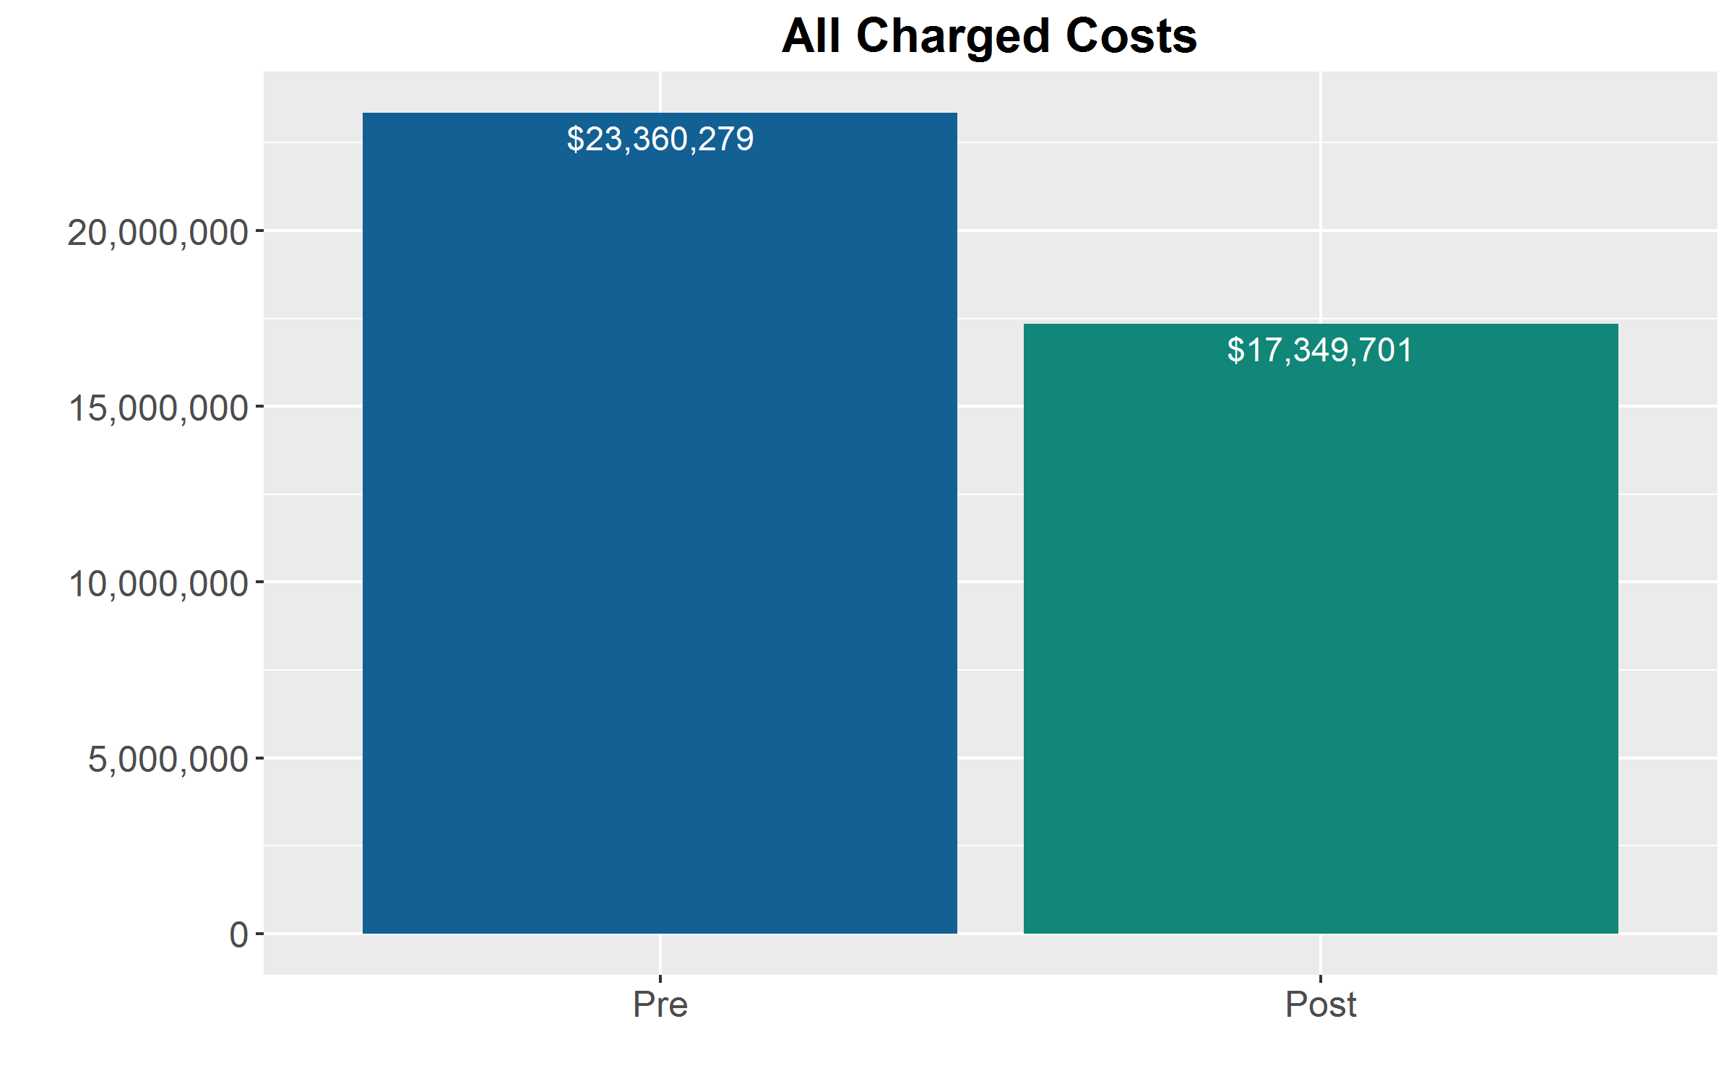
All Medical Charges
Total medical charges were $6,010,578 (34%) less in the post-intervention period
Does not include pharmacy claims
See analysis caveats and limitations slide for discussion
Claims Charge Data

Slide 42
Caveats and Analysis Limitations
Sample bias: Patients were chosen by BHOs based on a comprehensive list
Comment: While considered a bias in sampling, this may represent a policy means to engage health care organizations around a goal of health improvement
Observational vs Controlled: There was no control group for this analysis.
Conclusions are observational in nature
Results may be attributed to intervention and/or other uncontrolled for factors
Seasonality of behavior
Sampling/Selection – Patients already in a care management program; etc.
Claims and Clinical Data Limitations: There is a big difference between claims and clinical data.
Clinical data – clear date and time but missing “high risk” data/encounters (MH/HIV)
Claims – time is not included: must go through a manual process to create claims “encounters”
Claims Lag – Since the analysis ended in July 2016, claims continue to run-out
Costs are difficult to aggregate for ED based on Claims
Consultants
Facility Fees
Ancillary services
Did not look at “appropriate” vs “inappropriate” use of the ED
Data was not age or severity risk adjusted

Slide 43
Study Continuation
Analysis will be continued in SIM Grant Year 4
Address claims lag
Analyze paid data vs charge data
Increase timeframe (look-back period and intervention period (12 month)
Addition of control group/population – Allowing SIM to understand the impact of policy change (e.g. BHH) and other factors
Addition of pharmacy claims
Review polypharmacy impact
Review $ impact
Analyze “appropriate” vs “inappropriate” ED utilization

Slide 44
Behavioral Health Conclusions
The cost of advanced EHR technology is significant, with financial support the BH community can participate in data sharing
With access to real time medical data via HIE services, BH care teams are able to enhance their “health home” and intervene to improve patient experience, appropriate utilization, and reduce cost
Data integration into workflow is resource intense for BHOs, but when coordinated and “data informed” the impact can be significant. Few BHOs have dedicated staff to care management and workflow optimization.
DHHS will continue this work – through SIM Year 4
Add new data elements to HIE – BH Prior Authorizations
Expand HIE access
Fill in the gaps of the observational study
Understand how to go after CMS 90/10 match funding $$

Slide 45
Discussion
Thank you!
Shaun T. Alfreds, Chief Operating Officer
salfreds@hinfonet.org
Katie Sendze, Director of Client Services
ksendze@hinfonet.org

